Slide 1
Nothing But Blue Skies? —
The Unredeemed Promise of IP Enforcement at China’s Trade Fairs
Mark Cohen
Mark.Cohen@law.berkeley.edu
October 2018

Slide 2
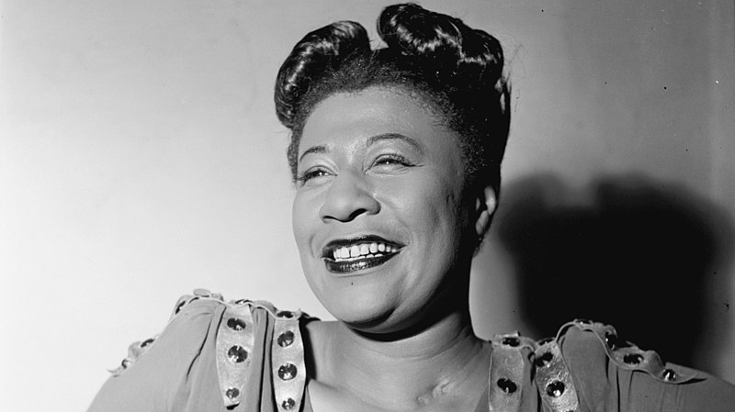
Blue Skies
Nothing But Blue Skies
Do I See…
Ella Fitzgerald
photo source: © William P. Gottlieb - This image is available from the United States Library of Congress's Prints and Photographs division under the digital ID gottlieb.02871.

Slide 3
History of Trade Fair Enforcement
1. Post WTO Acccession (12/2001): Nominal implementation of WTO commitments for courts to issue preliminary injunctions that could be used to address trade fair infringements; “local protectionism” by local courts may reduce actual availability of judicial relief for trade fair infringements
2. 2007: China begins to recognize the importance of imposing responsibilities on trade fair organizers through launching of an intergovernmental “blue sky” campaign specifically addressed to trade fair complaints.
  As with most special campaigns, the impact was largely short term.
  China also takes important steps to clarify third party liability standards and “offers for sale” as infringing acts
3. Courts continue to play a limited role in providing provisional relief for IP enforcement at trade fairs.
  Trade fair actions are primarily being launched after conclusion of a trade fair
  Infringers are hardly deterred from future action.
  Sponsors may be held liable.
  Trade fairs serve important evidence gathering opportunities.
  Overseas litigation against Chinese exhibitors increasingly of concern.

Slide 4
Phase 1 –
“Abro” Case
China’s Revised Trademark Law (2002):
Article 57 Where the owner of a registered trademark or any interested party has evidence proving that another party is committing or will soon commit an act that infringes upon his exclusive right to the use of its registered trademark and that, unless it is stopped promptly, will cause irreparable harm to his legitimate rights and interests, he may, before filing a lawsuit, apply to the People's Court for ordering the cease of the act and for adopting measures to preserve his property.

Slide 5
But Limited Availability
The Korean delegation to the WTO asked about frequencies with which provisional measures were granted:
20. What is the approximate rate of the provisional measure filings that are affirmed by the People's Courts?
“There is [sic] no statistics for such rate. The application by the parties for ordering provisional measures will be approved if the requirement of the relevant laws and regulations are [sic] satisfied.”
IP/C/W/374/Add.3 Page 14. , REVIEW OF LEGISLATION Responses from China to questions posed by the European Communities and their member States, Japan, Korea and Switzerland Addendum (May 19, 2003).

Slide 6
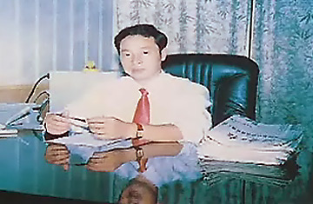
ABRO Case
America’s Most Wanted Counterfeiter (Time Magazine, 1/16/08)
“In 2003 Timothy Demarais, vice president of [ABRO]… walked into the Canton Trade Fair in Guangzhou, China, and found that his company's product line — and his company's identity itself — had been knocked off by a Chinese firm called Hunan Magic Power, also known as Magpow. When Demarais attempted to have the imposter kicked out, he says, Hunan Magic Power chairman Yuan Hongwei produced documentation that he claimed showed his company had the right to use the trademark ABRO. He had even copied ABRO's labeling, including one sample card with a photo of a woman applying epoxy to a bicycle. The woman, it turned out, was Demarais' wife. After Demarais pulled out another photo of his wife from his wallet, the trade fair officials booted Hunan Magic Power. ‘How blatant can you be when you steal my wife's picture for your card?’ asks Demarais.”

Slide 7
ABRO in Congress
Hunan Magic “operates openly within Hunan Province as they employ individuals and pay taxes” and “operate[s] with relative impunity in their local community and ha[s] shipped tens of millions of dollars of counterfeit ABRO products around the world and ha[s] destroyed many American jobs.” (Abro CEO, Peter Baranay in 2007 - https://waysandmeans.house.gov/Media/transcript/10248.html)

Slide 8
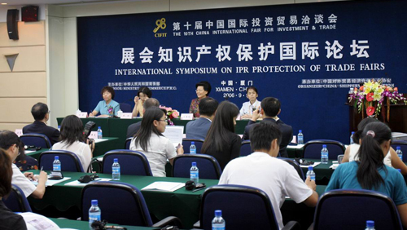
Phase 2: “Blue Sky” Protection Measures for Intellectual Property Rights During Exhibitions (2006)
Art. 6: If an exhibition lasts for 3 days or more and if the administrative department of exhibitions believes it is required, the exhibition sponsor shall establish an office in charge of IPRs complaints during the exhibition.
http://www.wipo.int/wipolex/zh/text.jsp?file_id=199512

Slide 9
Protection Measures for Intellectual Property Rights During Exhibitions
Art. 7: An office in charge of IPRs complaints in an exhibition [IP Protection Office or “IPPO] shall be comprised of the personnel from the sponsor of the exhibition, the administrative department of exhibitions, the IPRs administrative department in charge of patents, trademarks, and copyrights, and perform the following functions and duties: (1) Receiving the complaints of the IPRs holders, and suspending the item as suspected of infringement on IPRs on display during the exhibition; (2) Transferring the relevant complaint materials to the competent IPRs administrative department; (3) Coordinating and supervising and urging the treatment for complaints; (4) Carrying out the statistic and analysis on the information regarding the IPRs protection during the exhibition; and (5) Any other relevant matters.

Slide 10
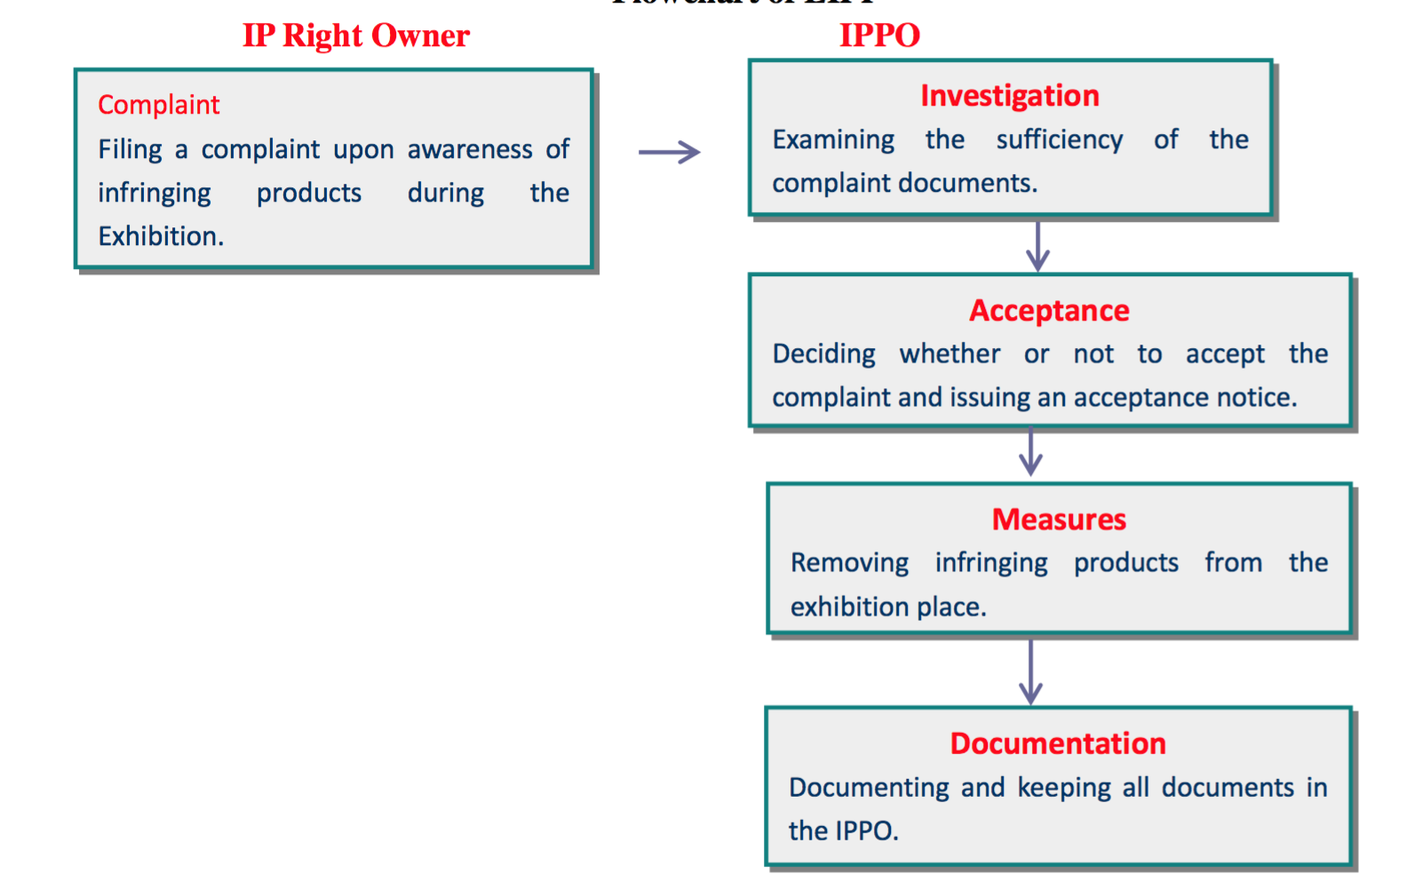
After having been found to have infringed more than two times, the exhibitor may be banned from the next conference.
第三十一条 参展方侵权成立的，展会管理部门可依法对有关参展方予以公告；参展方连续两次以上侵权行为成立的，展会主办方应禁止有关参展方参加下一届展会。

Slide 11
Local Rules in Response to the “Blue Sky” (Beijing)(Effective 03/01/2008)
Art. 9: Sponsor and exhibitor shall include in the exhibition contract a provision addresses the right, duty, and responsibility of IPR protection. IPR protection shall include:
  Exhibitor promises not to infringe others’ IPR
  The procedure for filing complaint and seeking relief
  Exhibitions that are complained of IP infringement shall be covered or removed from the exhibition

Slide 12
Local Rules in Response to the “Blue Sky” (Beijing)
Art. 18: Sponsor shall be responsible for the following:
  Accept and resolve complaints of IP infringement
  Provide consulting services regarding relevant laws of IPR protection
  . . .
  Provide evidence in response to IP owner’s request
Art. 21: Sponsor shall preserve the information collected during the exhibition and submit to the local IP Office.
Art. 24: Sponsors who fail to comply with arts. 18 & 21 can be fined no less than CNY 1,000 and no more than CNY 30,000.

Slide 13

Local Rules in Response to the “Blue Sky” (Guangzhou - Canton) (Effective 10/01 2009)
Art. 8: Sponsor shall be responsible for the following:
  Provide IP Admin Office contact information and pleading procedure,
  Provide consulting services to exhibitors regarding IPR protection
  Accept and resolve complaints
  Provide evidence in response to IP owner’s request
  Preserve information collected at the exhibition and submit to local IP Office after the exhibition.

Slide 14
Local Rules in Response to the “Blue Sky” (Guangzhou)
Art.11: IP owner shall provide evidentiary support along with the complaint. The sponsor shall process the complaint and inform the alleged infringer in a timely manner
Alleged infringer shall provide relevant evidence showing non-infringement. Products shall be covered or removed from the exhibition if failing to comply.
If complained products have been found to be infringing by a local court or IP administrative office, the sponsor shall cover up or remove the infringing products from the exhibition immediately.

Slide 15
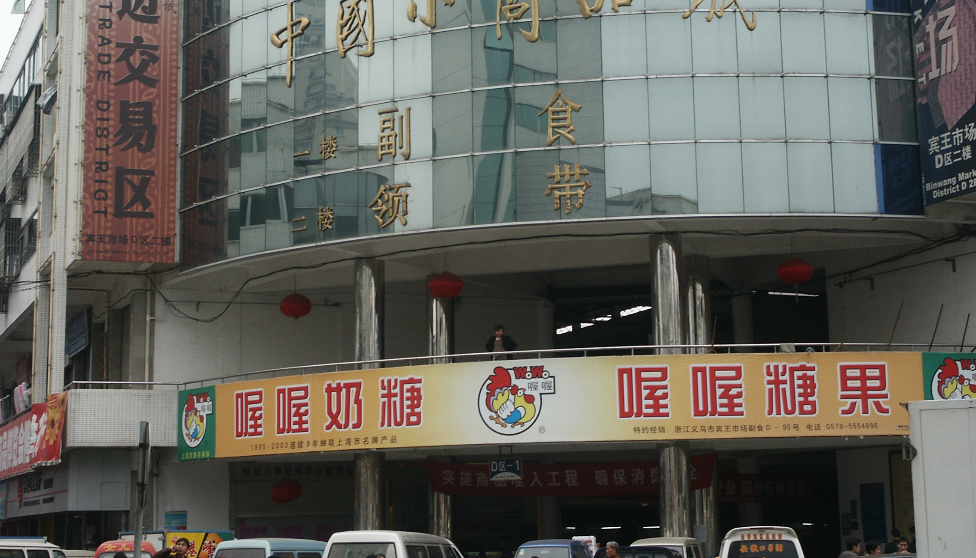
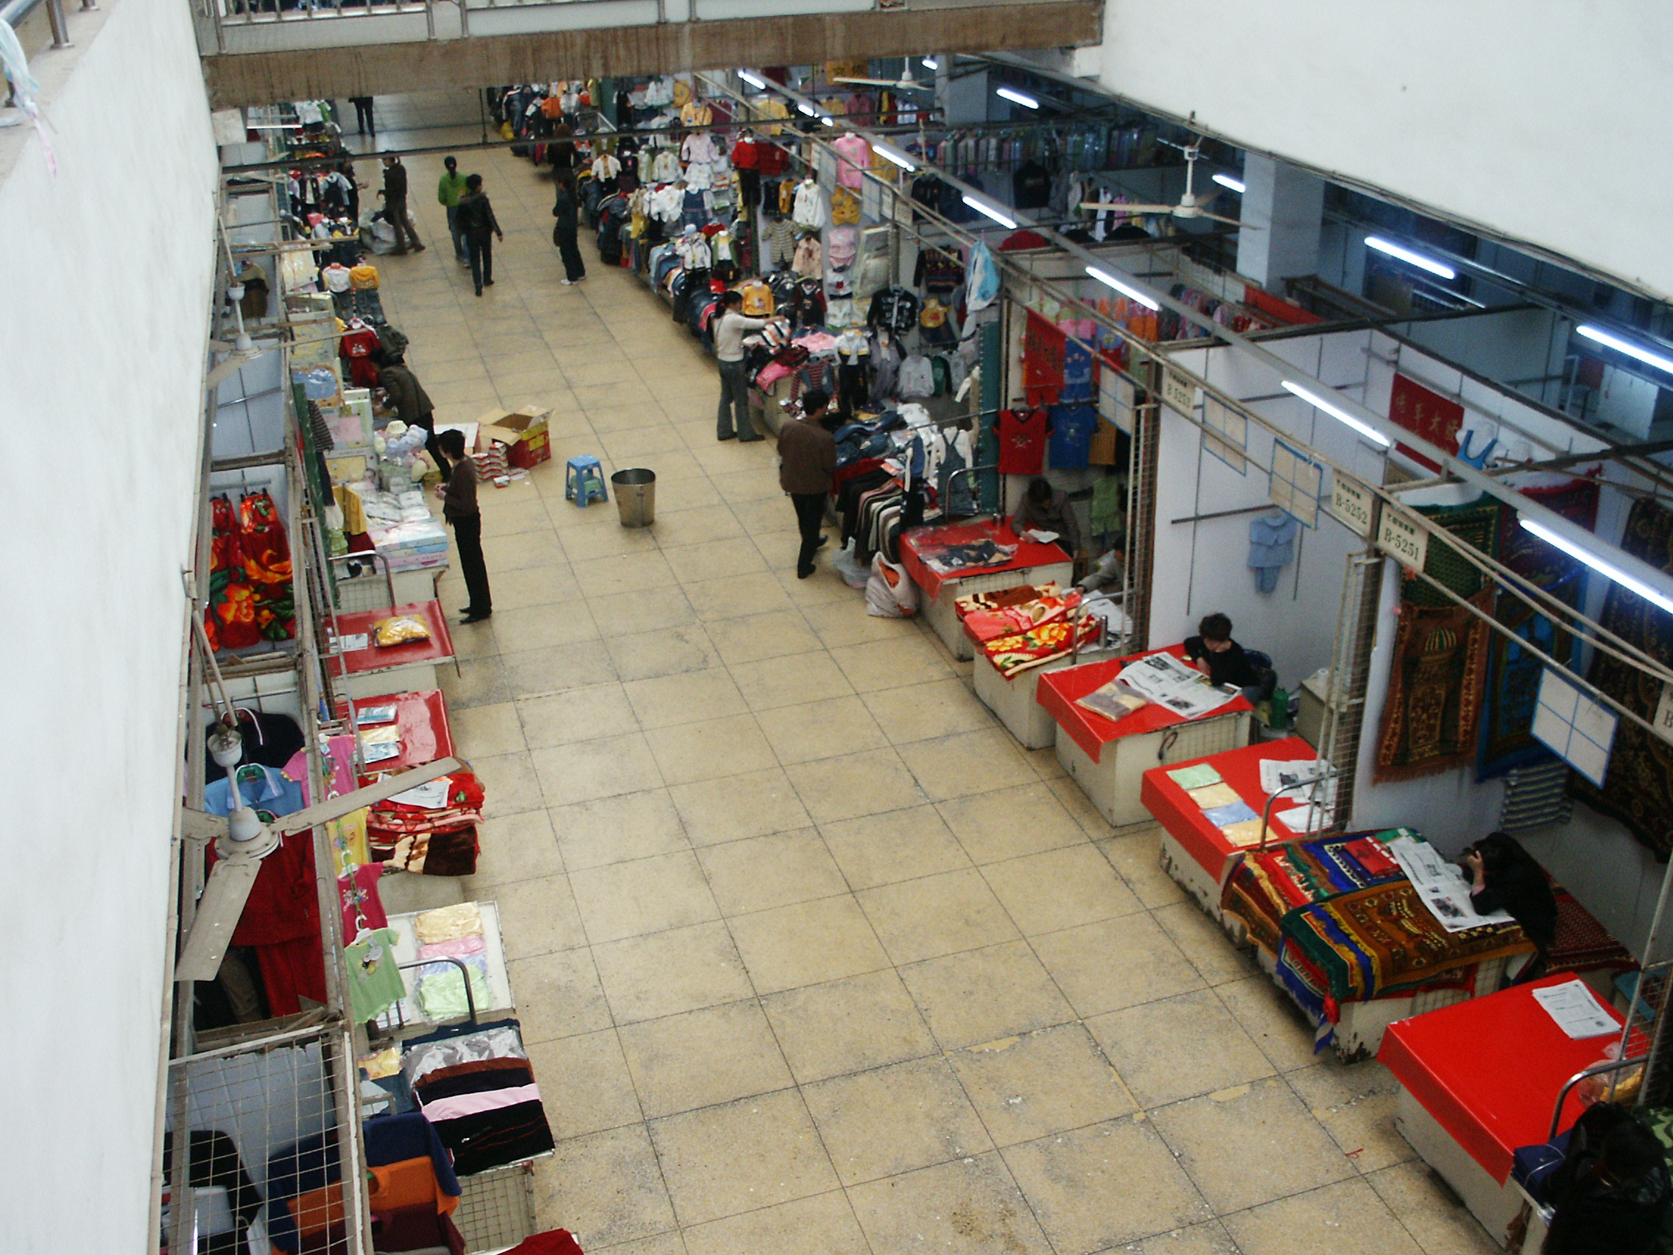
Local Rules in Response to the “Blue Sky” (Yiwu, Zhejiang) (Effective 10/20/2011)
Article 10: On-site IP Complaint Office is responsible for the following:
  Examine the IPR status of exhibiting products
  Accept and investigate any complaints of infringement
  Maintain a record of exhibition IP information
  Submit information to relevant authorities in a timely manner

Slide 16
Local Rules in Response to the “Blue Sky” (Yiwu, Zhejiang)
Article 13: The On-site IP Office shall inform any complaints to the complainee within two (2) hours
Article 15: If the complainee cannot make a showing that the product is non-infringing, the complainee shall remove itself from the exhibition. The On-site IP shall enforce such removal.
Article 17: The On-site IP Office shall, upon finding infringement, shall remove the infringing product from the exhibition within two hours.

Slide 17
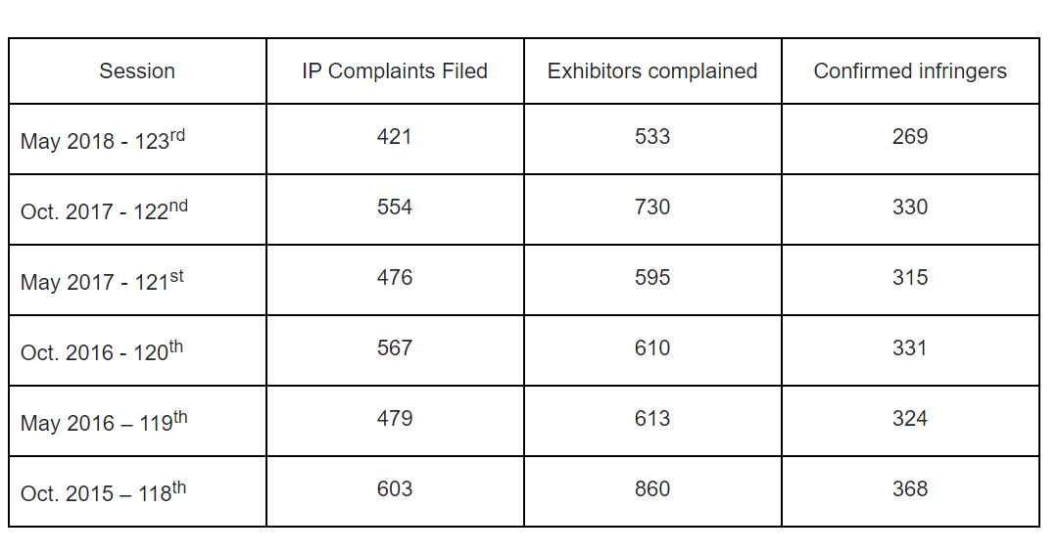
IP Investigations and Decisions made at Canton Trade Fair

Slide 18
What Blue Sky Delivered….
On-site IP Protection Office has the power to cover up or remove the infringing products from the exhibition
More or less functions as a TRO but for exhibition only
There are no other forms of TRO available at the trade fair
No cases yet found involving court orders (for preliminary injunction or evidence preservation at the fair)
There appear to be no adequate deterrent remedies at the trade fair, according to both the Protections Measures and the local rules.

Slide 19
Phase 3: Unredeemed Judicial Reform + Limited Blue Sky Impact
Number of IP Civil Cases involving “Canton Trade Fair”
Total: 633
Patent: 284
Trademark: 202
Copyright: 124
Unfair Competition: 26
Source: Iphouse database Sept. 2018 (www.iphouse.cn)

Slide 20
Number of IP Infringement Cases (by judicial procedure)
Total: 633
First Instance: 345
Second instance: 283
Retrial: 5

Slide 21
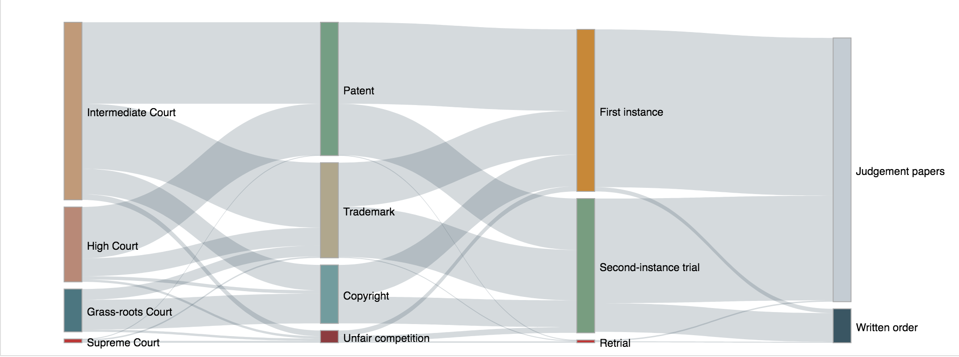
Trade Fair IP Cases Visualized

Slide 22
Trade Fair IP Infringement Cases By Jurisdiction
Guangdong: 359
Beijing: 116
Zhejiang: 86
Fujian: 24
Shanghai: 10
*Only jurisdictions that have heard more than ten cases are listed

Slide 23
Number of Cases Tried Over Years

Slide 24
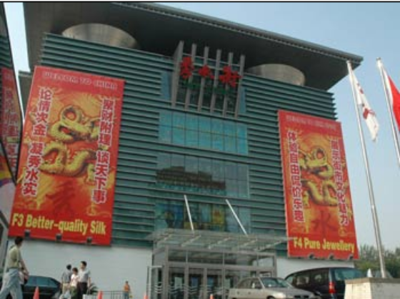
Trademark Cases
Total: 202
Trademark law revisions imposes liability for “intentionally” providing “conveniences” for infringers (Art. 57) (2013 rev.)
  Silk Market and other cases: landlord secondary liability for infringing acts of tenant/failed effort to extent to advertisers on websites distributing piratical goods.
Half of the trade fair cases have the Trademark Office listed as a defendant (93) – “invalidity” actions.
These cases involve:
  Plaintiff’s trademark being invalidated by the trademark office due to “non-use”
  Plaintiff showing evidence that they have used their trademarks in the Canton Trade Fair, i.e., for use in commerce
    Generally use for export constitutes use in commerce for purposes of maintaining TM registration, but may not constitute infringement under Chinese TM law.
  Therefore, the non-use allegation is rejected by the courts.
No case found thus far that held sponsor liable for infringement

Slide 25
Patent Cases that Involve Sponsor Liability
(a) Civil Procedure Law (2007) provides greater availability of provisional measures; (b) Article 70 of Patent Law (2008), includes “offers for sale” as infringing acts; (c)Article 9 of Tort Law (2009): One who abets or assists another person in committing a tort shall be liable jointly and severally with the tortfeasor.

Slide 26
 | (2017) Hu 73 Min Chu Zi No. 503¹ | (2016) Jing Zhi Min Chu Zi No. 907² | (2011) Er Zhong Min Chu Zi No. 10440³ | (2015) Jing Zhi Min Chu Zi No. 3⁴ | (2013) Ning Zhi Min Chu Zi No. 429⁵
Sponsor’s Role | Event Sponsor | D1: Venue provider D2: Event sponsor | Venue Provider & Management | Venue Provider | Venue Provider
Type of Patent | Design | UMP | Invention | Design | Design
Infringement found? | Yes | Yes | No | Yes | Yes
Liability? | *Defaulted | Event sponsor found contributorily liable | n/a | Did not mention in the judgment | No, only providing venue
1. 上海赫宾家具有限公司与台州市路桥昱美达梯业厂、上海京正展览服务有限公司侵害外观设计专利权纠纷侵害外观设计专利权纠纷案
2. 张伟东诉北京国展国际展览中心有限责任公司(简称国展公司)、北京中装华港建筑科技展览有限公司侵犯实用新型专利权纠纷案
3. 东莞市双知艺坊洁具有限公司诉被告北京励展华群展览有限公司、曾秋红侵害发明专利权纠纷案
4. 北京乐扣乐扣贸易有限公司诉被告温州市华赛日用品有限公司、北京励展华群展览有限公司侵害外观设计专利权纠纷案
5. 欧科佳(上海)汽车电子设备有限公司与被告宁波市鄞州雪利曼电子仪表有限公司、南京河西会议展览有限责任公司侵害外观设计专利权纠纷案

Slide 27
Provisional Measures in China (2013)
  Generally, high grant rate but low application rate for provisional measures.
  Continuing issues in transparency.
  Example of low application rate conundrum: In 2007, nation-wide courts in China respectively filed and concluded:
  - 134 and 131 preliminary injunction cases, with 76.92% ruling upheld the applicants;
  - 230 and 216 Pre-trial evidence preservation cases, with 87.17% ruling upheld the applicants;
  110 and 106 Pre-trial property preservation cases, with 98.10% ruling upheld the applicants.
  In 2007, nation-wide courts in China respectively filed and concluded 17,877 (.75% of the total docket) and 17,395 IPR civil cases of first instance (.75% of the total docket)
    Only a small percentage were foreign-related

Slide 28
Provisional Measures in China (2013)
11 cases involving application for preliminary injunction relating to intellectual property disputes; 77.78% were granted approval.
173 applications for pre-trial preservation of evidence were accepted, and 97.63% were granted approval.
47 applications for pre-trial preservation of property were accepted, and 96.97% approved.
Of course, one might ask if approval rates for provisional measures are so high, why then are applications for preliminary injunctions only about .01% of the total of disposed cases (approx. 90,000)? Why had the number declined since 2003?
https://chinaipr.com/2014/04/27/what-the-supreme-peoples-courts-data-for-2013-shows/

Slide 29
BUT… see Yangzhou Jinli Electric Tools Ltd. v. Grey Power Tool (Suzhou) Co.¹
The court mentioned in its procedural history that the trial court seized the alleged infringing product at the 93rd Canton Trade Fair in 2003
The plaintiff also asked & paid for preliminary injunction. The court did not mention whether the trial court granted the PI motion, but only stated that the trial court seized the infringing product (not at the trade fair but at defendant’s address.)
1. 上诉人扬州金力电动工具有限公司与被上诉人格雷电动工具(苏州)有限公司、原审被告南京机械五金矿产医药保健品进出口有限责任公司专利侵权纠纷案 (2006) 苏民三终字 0006号

Slide 30
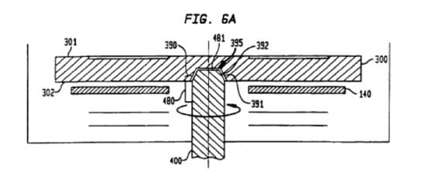
But see…
Micron and Veeco preliminary injunction cases (2017/2018)
  Non trade fair related
  No published decisions
    Veeco PI resulted in global cross-license
  Allegations of use of preliminary injunctions to support local industry
  Source: https://chinaipr.com/2018/07/04/semiconductor-patent-litigation-part-2-nationalism-transparency-and-rule-of-law/

Slide 31
Trade Fair Litigation Functioning as an Evidence Investigation/Quasi-Discovery Mechanism
Notary Publics present at trade fair venue
  Notarized evidence necessary to satisfy judicial formalities in China
Evidence, photos taken, brochures, and catalogues can all be notarized
Evidence collected at the trade fair is also used to counter any non-use allegations by the Trademark Office

Slide 32
Research Method and Limitations
Source: IPHouse (http://en.iphouse.cn/index.html)
Search Method: Search “Canton Trade Fair” (广交会)
Searched in result for “Patent” and ”Trademark,” respectively
Searched in result for “Preservation of Evidence” (证据保全)
Searched in result for “Preliminary Injunction” (诉前禁令)
Limitations: IPHouse only provides Court Opinions and Written Court Orders (which are issued when the plaintiff seeks to dismiss the case). This database does not include pre-trial orders, motions, or writs. This database also does not record cases that are dismissed preliminarily.

Slide 33
Phase 3 ½: Trade Show-Related TRO Cases in the United States
Source: LexisNexis, Bloomberg Law and Marketa Trimble’s article (Marketa Trimble, Temporary Restraining Orders to Enforce Intellectual Property Rights at Trade Shows: An Empirical Study, 83 Brook. L. Rev. __ (forthcoming 2018)).
Search Method: Search public opinions in LexisNexis using search terms shown as below, then cross-reference docket entries in Bloomberg Law. Eleven cases mentioned in Marketa Trimble’s article are also included.
“trade show /50 temporary restraining order” and filtered by “China or Chinese”/Taiwan*/Japan*/Korea*/German*
“trade show /50 injunction” and filtered by “China or Chinese”/Taiwan*/Japan*/Korea*/German*
“trade show /50 TRO” and filtered by “China or Chinese”/Taiwan*/Japan*/Korea*/German*
Limitations: This dataset may not be comprehensive as certain temporary restraining orders do not come with an issued opinion. Also, not every opinion mentions the nationality of parties involved.

Slide 34
Trade Show-Related TRO Cases Filed in U.S. District Courts 2009-2018
 | Case Name | Court | Domicile of Defendant | Type of IP Right | TRO Decision Date | TRO Decision | Bond Deposit
1 | Equalia, LLC v. Kushgo LLC, 2017 U.S. Dist. LEXIS 4112* 2:16-cv-02851-RFB-CWH | District of Nevada | China | Patent | 11-Jan-17 | Granted | 50,000
2 | Omix Ada, Inc. v. Changzhou Jiulong Auto Lamps Factory et al* 2:16-cv-02527-GMN-CWH | District of Nevada | China | Patent & Trademark | 1-Nov-16 | Granted | 10,000
3 | Aker BioMarine Antarcitic, AS v. Luhua Biomarine (Shandong) Co., Ltd. et al* 2:16-cv-02314-MMD-PAL | District of Nevada | China | Patent | 5-Oct-16 | Granted | 50,000
4 | Nike, Inc. v. Fujian Bestwinn China Indus. Co., 166 F. Supp. 3d 1177* 2:16-cv-00311-APG-VCF | District of Nevada | China | Patent | 17-Feb-16 | Granted | 25,000
5 | Future Motion, Inc. v. Changzhou First Int‘l Trade Co., 2016 U.S. Dist. LEXIS 136871* 2:16-cv-00013-MMD-CWH | District of Nevada | China | Patent | 6-Jan-16 | Granted | 10,000
6 | SATA GmbH & Co. KG v. Zhejiang Refine Wufu Air Tools Co., 2015 U.S. Dist. LEXIS 151033* 2:15-cv-02111-GMN-CWH | District of Nevada | China | Patent | 5-Nov-15 | Denied | N/A
7 | Neptune Techs. & Bioressources, Inc. v. Luhua Biomarine Shandong Co., 2015 U.S. Dist. LEXIS 192570* 2:15-cv-01911-JCM-CWH | District of Nevada | China | Patent | 7-Oct-15 | Granted | 50,000
8 | Wenger S.A. v. Fuzhou Hunter Prod. Imp. & Exp. Co., 2015 U.S. Dist. LEXIS 85855* 2:15-cv-01098-GMN-NJK | District of Nevada | China | Trademark & Copyright | 10-Jun-15 | Granted | 7,500
9 | Toyo Tire & Rubber Co. v. Kabusikiki Kaisha Tokyo Nihoon Rubber Corp, 2015 U.S. Dist. LEXIS 146294* 2:14-cv-01847-JAD-VCF | District of Nevada | Japan | Trademark | 12-Nov-14 | Granted | 50,000
10 | Hand & Nail Harmony, Inc. v. Guangzhou Cocome Cosmetics Co., 2014 U.S. Dist. LEXIS 102525* 2:14-cv-01106-RFB-CWH | District of Nevada | China | Trademark | 15-Jul-14 | Granted | 5,000
11 | Empire Level Manufacturing Corp. v. Toolrich Imp. & Exp. Co., Ltd. et al * 2:14-cv-00718-GMN-CWH | District of Nevada | China | Trademark | 8-May-14 | Granted | 10,000
12 | Rubbermaid Commercial Products LLC v. Trust Commercial Products ET AL 2:13-cv-02144-GMN-GWF | District of Nevada | China | Patent | 21-Nov-13 | Granted | 50,000
13 | SATA GmbH & Co. KG v. Wenzhou T&E Industrial Co., Ltd. et al 2:13-cv-02042-APG-NJK | District of Nevada | China | Patent & Trademark | 6-Nov-13 | Granted | 15,000
14 | Interactive Life Forms, LLC v. Weng, 2013 U.S. Dist. LEXIS 194195 A-12-CA-1182-SS | Western District of Texas | China | Patent & Trademark | 15-Jan-13 | Granted | 50,000
15 | Hand & Nail Harmony, Inc. v. Guangzhou Shun Yan Cosmetics Co. 2:12-cv-01212 | District of Nevada | China | Trademark | 19-Jul-12 | Granted | 5,000
16 | Contour Design, Inc. v. Chance Mold Steel Co., 2011 U.S. Dist. LEXIS 145321 09-cv-451-JL | District of New Hampshire | Taiwan | Trade Secrets | 14-Jan-10 | Granted | 50,000
17 | Too Marker Prods. v. Shinhan Art Materials, Inc., 2009 U.S. Dist. LEXIS 114504 | District of Oregon | Korea | Trademark | 3-Dec-09 | Denied | N/A
18 | Snap-On Inc. v. Robert Bosch, LLC, 2016 U.S. Dist. LEXIS 56465 09 CV 6914 | Northern District of Illinois | German | Patent | 4-Nov-09 | Denied | N/A
* Cases that are also mentioned in Marketa Trimble’s article (Marketa Trimble, Temporary Restraining Orders to Enforce Intellectual Property Rights at Trade Shows: An Empirical Study, 83 Brook. L. Rev. __ (forthcoming 2018)).

Slide 36
Tentative Conclusions
In China –
  Blue Sky Type Efforts: Low deterrence, high utilization, informal (inexpensive?)
    Failed to deliver on promise of reducing local protectionism
    Non-deterrent remedy
    Are trade fair sui generis mechanisms as implemented a Chinese legal “dinosaur” when compared to an increasingly expert judiciary in China with the largest docket in the world?
  Civil Infringement: Little used for TRO-type remedies
    Little overall use of TRO’s/preliminary injunctions
      Lack of transparency
    More extensive secondary liability for trade fair organizers/sponsors than in the US
  Trade Fairs do remain important sources of information for evidence gathering/defeating non-use allegations/proof of infringement as an “offer for sale” in the Chinese courts.
In United States
  Chinese defendants are an important part of the trade fair / TRO docket
  Little data on how much US companies utilize the Chinese system and/or consciously choose US remedies in lieu of Chinese sui generis or civil remedies.

Slide 37
The End!

